Slide 1


bestIMAGE 5.50
Exlore the new features of
CAM Plus

Slide 2
NEW FeatureS
ONFLY engraving of new standard formats (TIFF, Esko LEN).
Output job templates to speed up output job creation.
Job automation support. (job database to spool jobs direct to output machines).
Embed fonts for text objects.
Raster dot jitter for highlights to prevent Moiré effects.
New FM Raster "Clear dots" for smoother prints than traditional Random raster.
Job editor supports "Drag and drop" of individual parameters between objects.
Editable Mesh list for screen printing forms.
Job editor works more fluent because user must not wait till object placement is ready calculated.
Engraving job statistics (jobs per day/week/year).

Slide 3

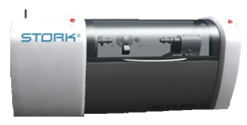

On-fly support of standard formats: PDF, TIFF, (Esko) LEN
PDF
LEN
TIFF
No conversion needed for most popular file formats!
(Of course Stork Prints’ LYR and DLE are also supported for ON-FLY engraving)

Slide 4
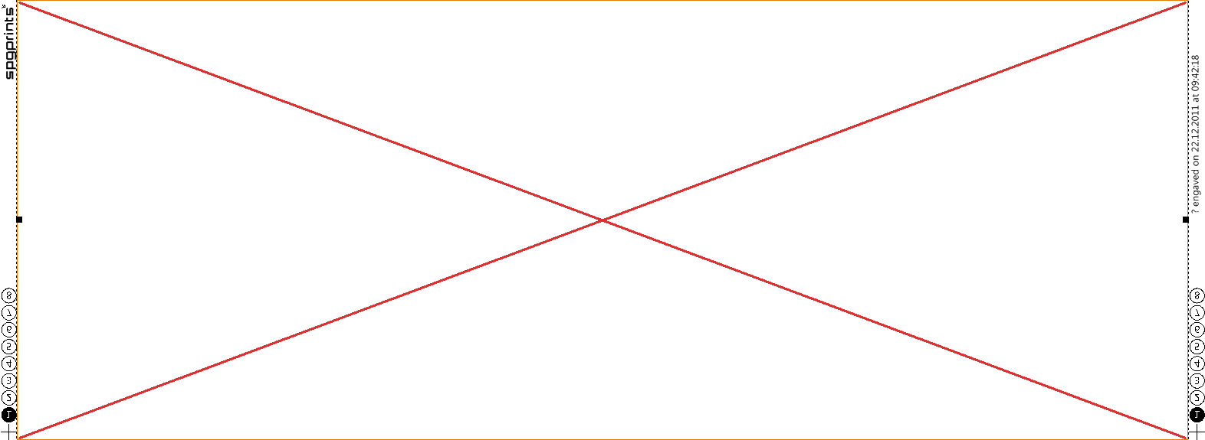
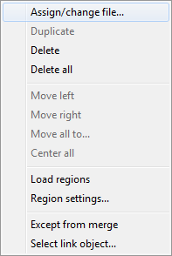

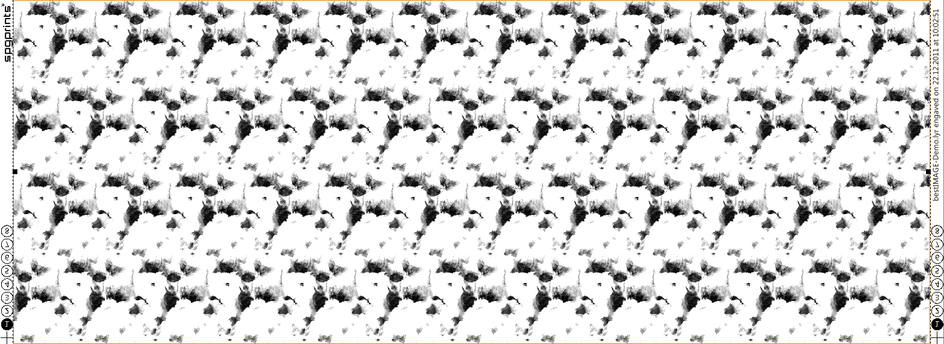
Output job templates
LYR
Job templates speed up the creation of output job layouts.
Just load template (*.EJT) and assign your *.LYR (*.PDF, *.DLE, *.LEN) file.
The registration marks and logo images as well as boarder text will be adapted via the macros.
You can use existing jobs (*.EJB) and simply save them as templates (*.EJT) to create new templates.

Slide 5
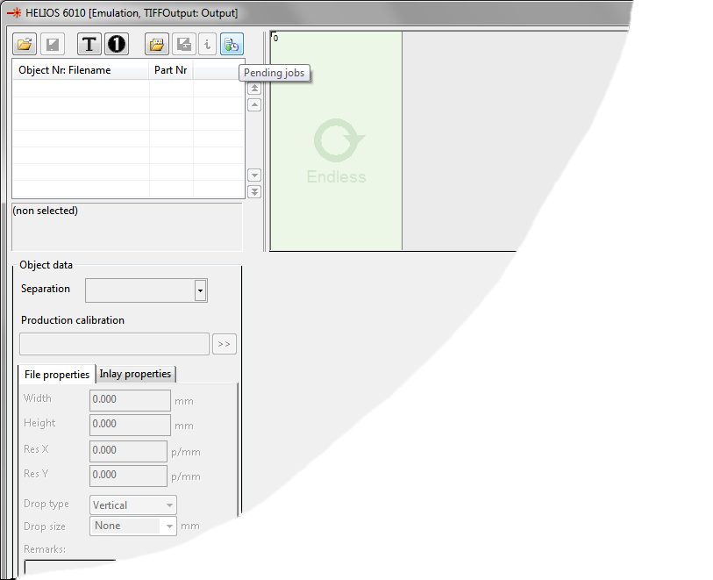
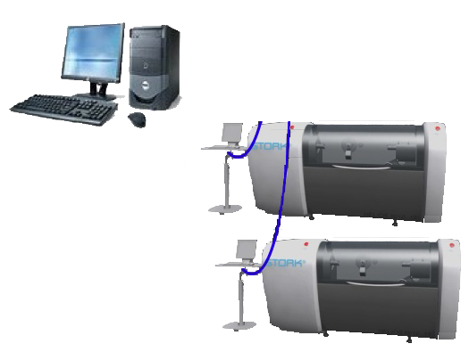
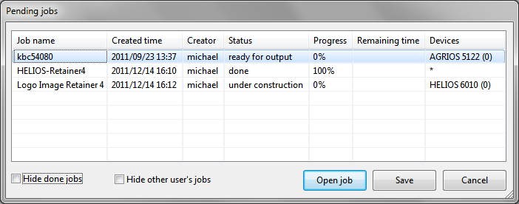
Job automation
Network
With new job editor you can setup jobs on your CAD system and spool them direct to the device, where operator gets informed about the new job.
You can monitor on the CAD station (or Flexo power station) about the progress of your jobs on all machines.

Slide 6
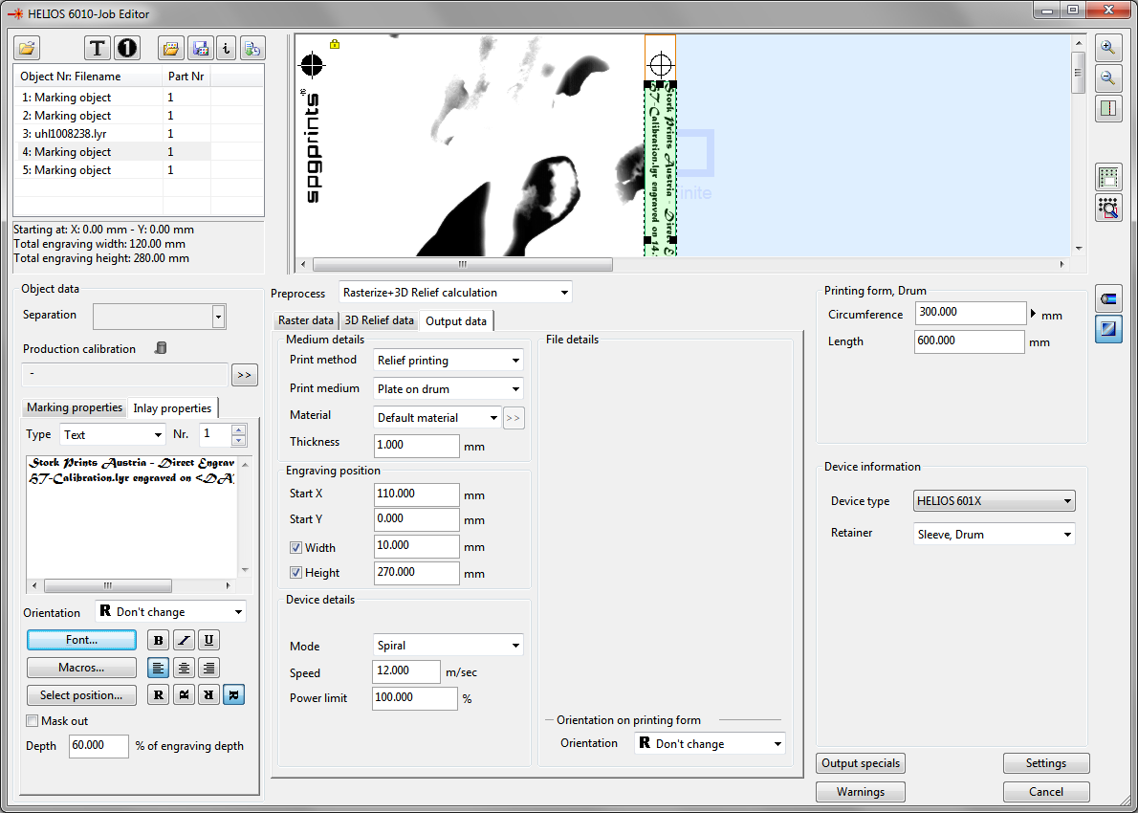
Embedded Fonts for Jobs
EJB
You now can embed fonts for inlay text objects or text objects into the *.EJB jobfile to be sure your output machine PC will have the correct font.
Additionally font warning and font replacement is now integrated for not embedded fonts.

Slide 7
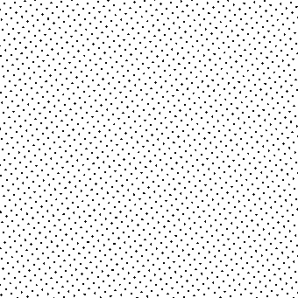

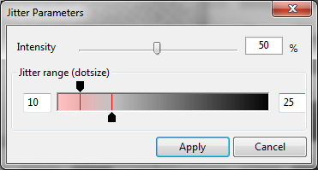
Raster-Dot Jitter
Raster dot position jitter can now be added to avoid Moiré effects.
This jitter can be defined by intensity and can be applied smooth form highlights to mid-tones.

Slide 8
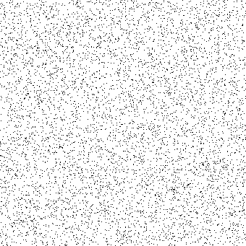

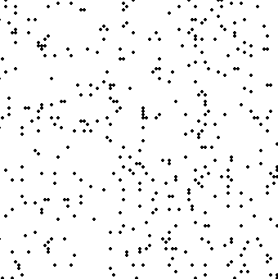
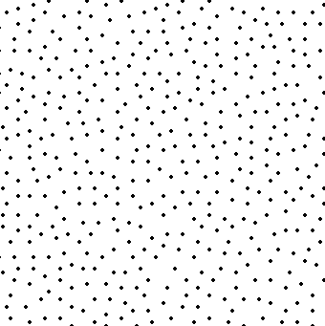
New FM Raster "Clear dots"
The new “Clear dots” Raster does not place dots completely by random, but has the intelligence to spread points homogeneous.
This leads to smoother prints than traditional Random raster.
It is also possible to generate square or round FM raster dots composed of several pixels.

Slide 9
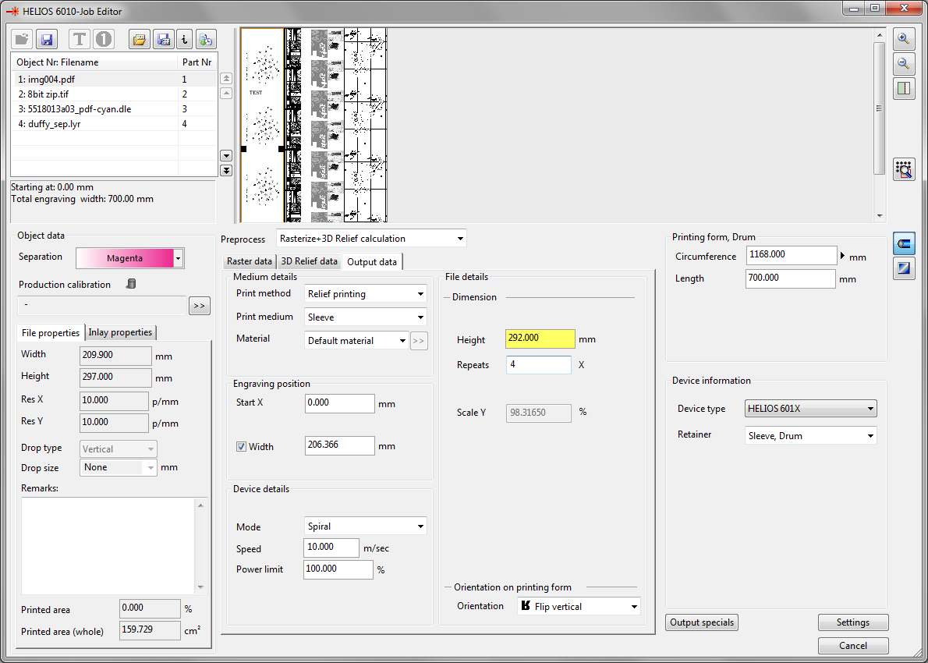
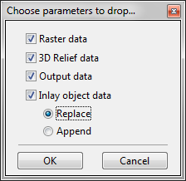
"Drag and drop" of individual parameters
Ctrl+Shift with drag and drop
It’s now possible to copy just a subcategory of parameter between output objects.

Slide 10
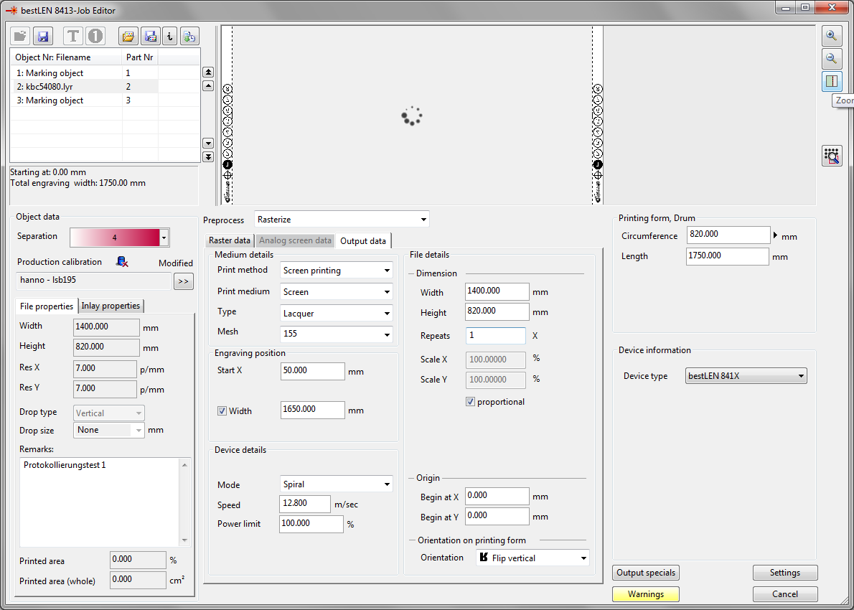
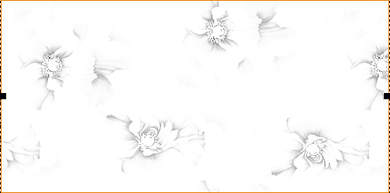
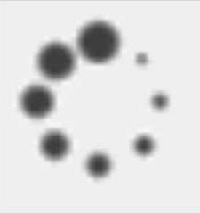
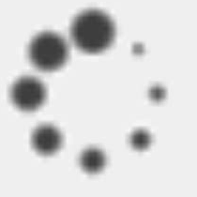
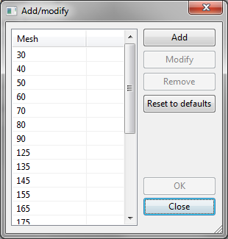
Minor improvements
Job parameter can be changed fluent as user has not to wait for
preview updates
Preview updates do no longer stall user from fluent working.
Screen mesh list is now editable.

Slide 11
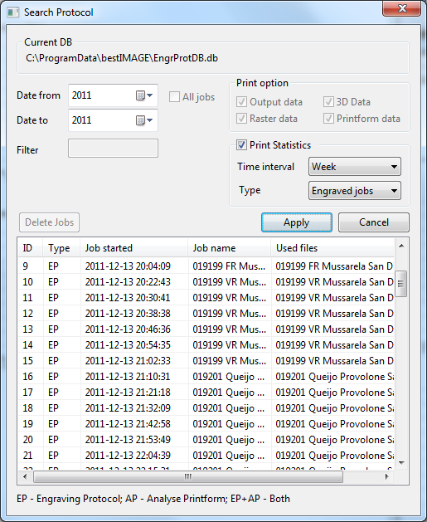
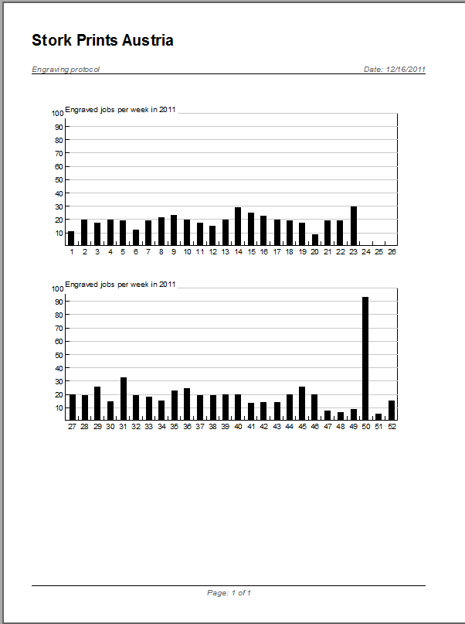
Engraving job statistics
Statistical data can now be extracted from job report database like:
jobs/week
jobs/day
jobs/month.

Slide 12

Copyright © 2011 by Stork Prints Austria GmbH. Permission to copy without fee all or part of this material is granted provided that the copies are not made or distributed for direct commercial advantage and the Stork Prints Austria copyright notice appears. If the majority of the document is copied or redistributed, it must be distributed verbatim, without repagination or reformatting. To copy otherwise requires specific permission from Stork Prints Austria GmbH.
Stork Prints may make changes to specifications and product descriptions at any time, without notice.

